Slide 1
SWE3002: Information & Systems Security
Module 2 DES
Prof. Jayasudha M, VIT Chennai

Slide 2
Block Cipher
Map n-bit plaintext blocks to n-bit ciphertext blocks (n = block length).
For n-bit plaintext and ciphertext blocks and a fixed key, the encryption function is a bijection;
E : P_{n} x K → C_{n} s.t. for all key k ∈ K, E(x, k) is an invertible mapping, written E_{k}(x).
The inverse mapping is the decryption function, y = D_{k}(x) denotes the decryption of plaintext x under k.

Slide 3
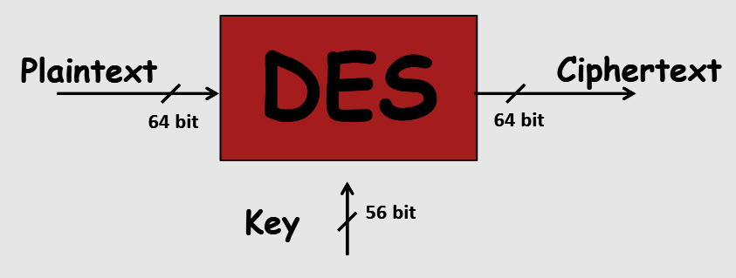
DES specifications
64-bit block cipher
56-bit key (the key is technically 64 bits but 8 are used as parity bits for error correcting making the effective security equivalent to a 56-bit key)
16 round Feistel cipher
The round function requires 48 bits of input – Uses 8 S-boxes of 6-bits each
Different 48 subkey used for each round

Slide 4
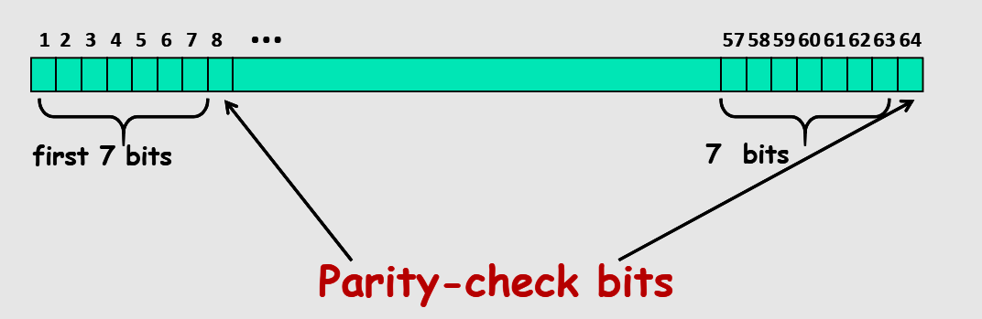
Key length in DES

Slide 5
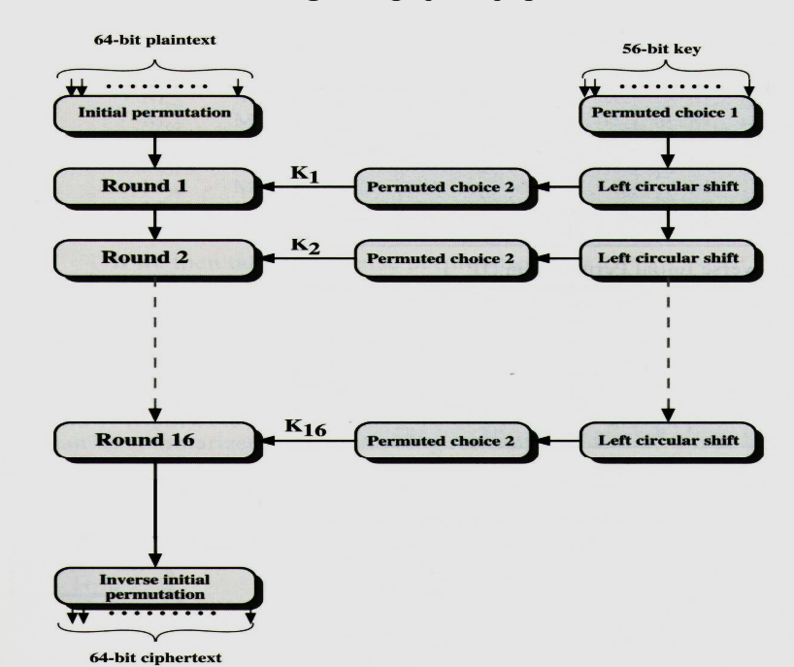
DES Rounds

Slide 6
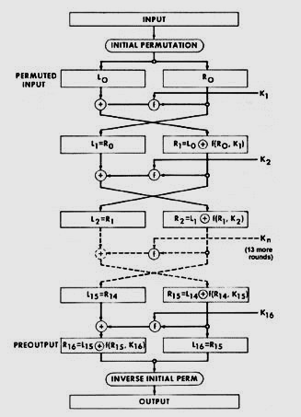
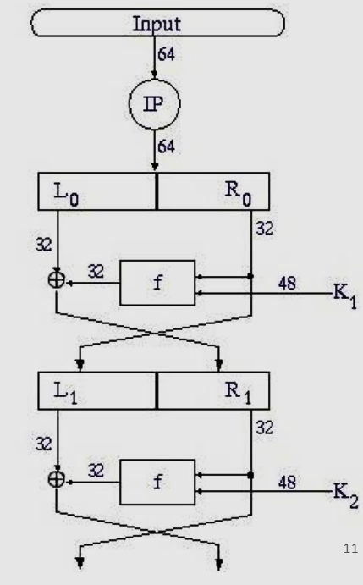
Key Generation

Slide 7
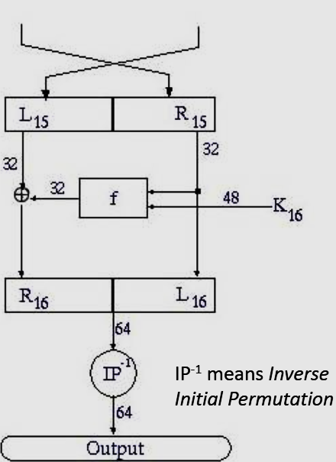
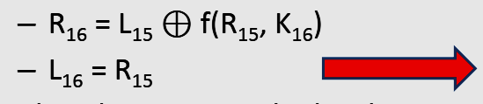
Key generation cont.,

Slide 8
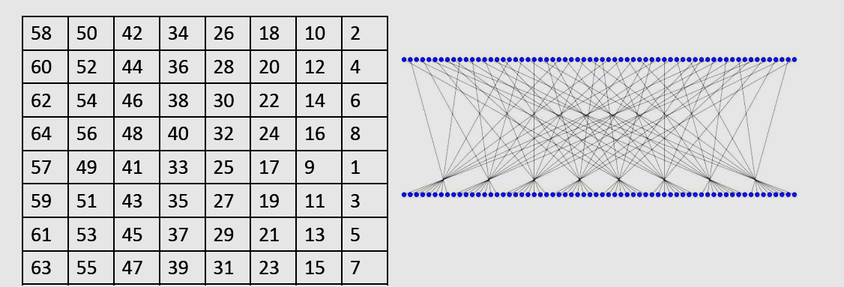
Initial Permutation

Slide 9
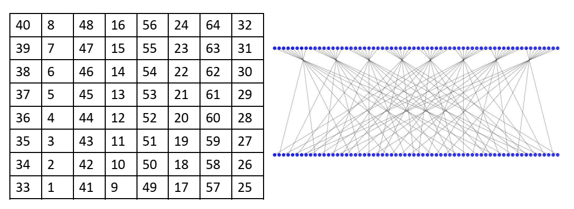
Final Permutation

Slide 10
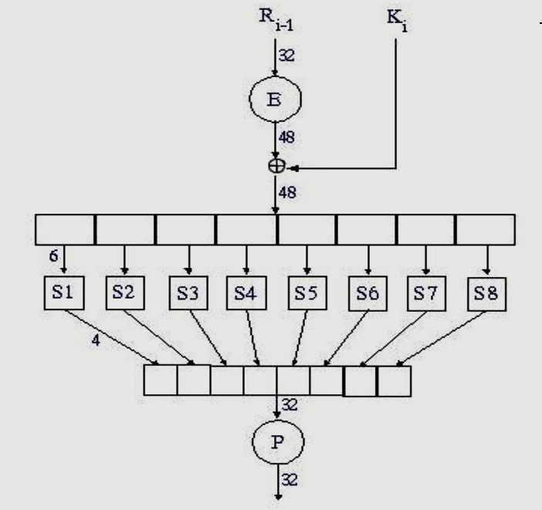
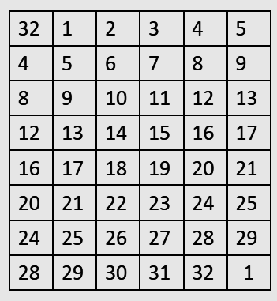
DES round f(.) function

Slide 11
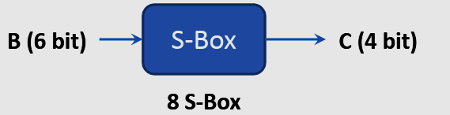
S-boxes
S-boxes are the only non-linear elements

Slide 12
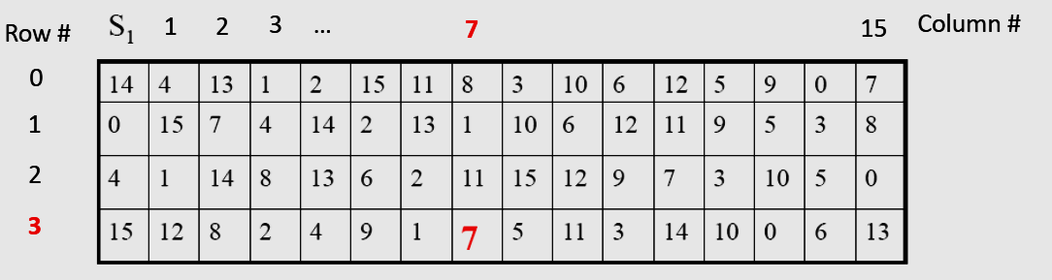
Example
B=101111
B=011011

Slide 13
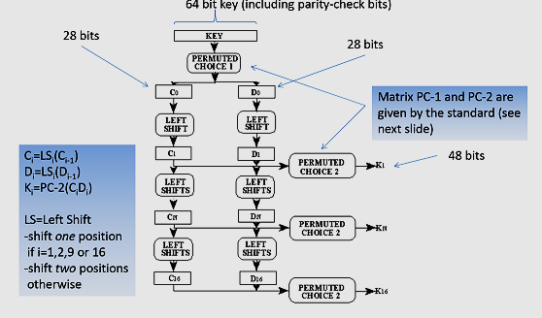
DES Key Generation(K1—K16)

Slide 14
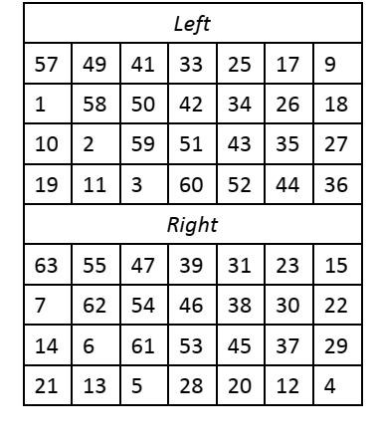
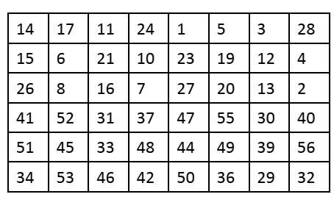
DES Permuted choice 1 and 2
PC1
PC2

